Slide 1


Asphalt Shingles Recycling
Training Guide for Suppliers
PROVIDED BY:

Slide 2
WHO IS REQUIRED TO COMPLETE TRAINING ?
WHAT TO COMPLETE BEFORE BRINGING SHINGLES TO EACH FACILITY?
Complete, Sign and Submit:
Supply Training Manual / Supply Certification Form
Receipt & Processing Service Agreement
Certificate of Insurance
Credit Application
(Not Necessary for COD)
5. Address Tracking Sheet
Suppliers Requiring Training:
General Contractors
Roofing Contractors
Homebuilders
Homeowners
Permitted C&D Facilities
Waste Management Facilities

Slide 3
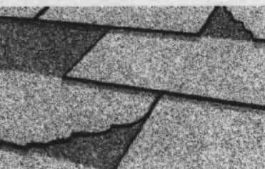
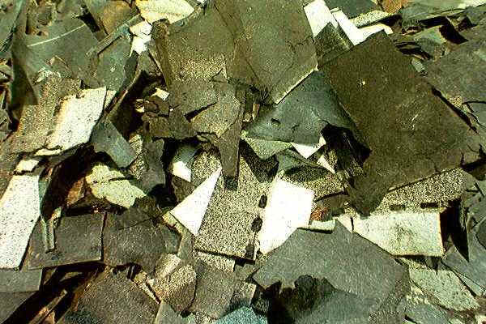

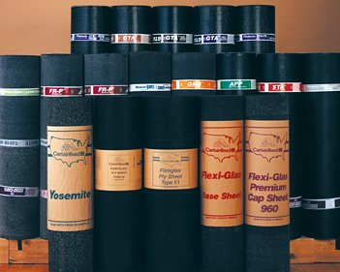
ACCEPTABLE MATERIALS
UNACCEPTABLE MATERIALS
Asphalt Shingles
Felt Attached to Shingles
Nails Mixed with Shingles
Cedar Shingles
Built-up Asphalt Roofing & Flat Roofing Shingles
Rolls / Sheets of Felt Paper
Asbestos / Any Material
Containing Asbestos
Household Trash

Slide 4
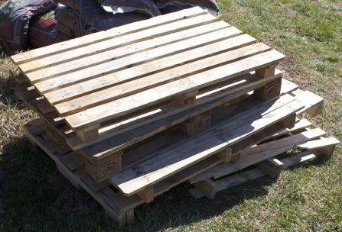
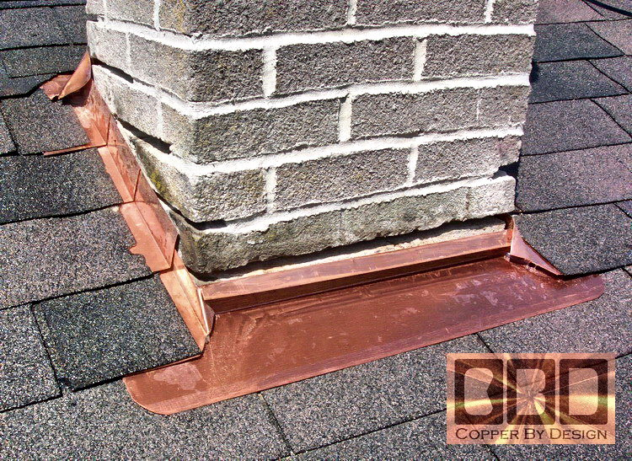
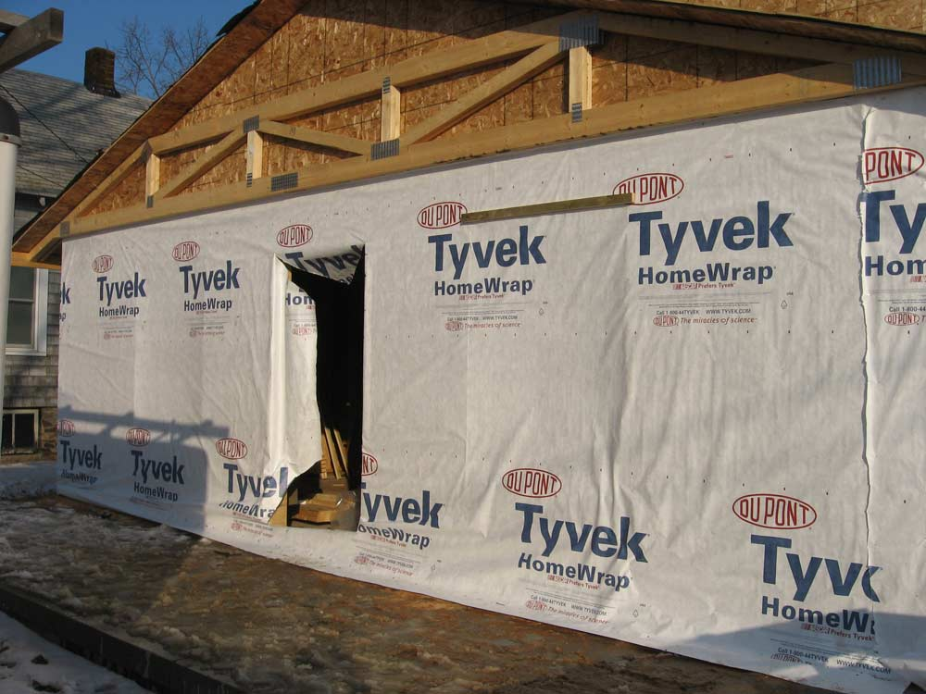
YOUR BEST EFFORT MUST BE MADE TO REMOVE THE FOLLOWING:
Wood (Plywood, Pallets, Etc.)
Metal (Gutters, Flashing, Etc.)
Plastic Wrap, Paper

Slide 5
HOW TO COMPLETE THE REQUIRED FORMS
Supply Training Manual / Supply Certification Form:
  Complete, sign and submit form by authorized agent of the company once you read this “Asphalt Shingles Recycling Training Guide for Suppliers” (One Time)
Receipt & Processing Service Agreement:
  Complete and sign when initially registering as a new customer
3. Certificate of Insurance:
  Provide when initially registering as a new customer
  Provide company proof of insurance annually
Credit application if you desire to open an account (Not necessary for COD)
Address Tracking Sheet:
  One form per facility with an address tracking list submitted each week / month providing where shingles come from

Slide 6
REQUIREMENTS FOR EACH LOAD
Staff visually inspects each load
The on-site Illinois Certified Asbestos Inspector will monitor activities and conduct sampling procedures to address concerns associated with Asbestos Containing Material
Any load rejected must be dealt with using Best Management Practices. A form will be issued to the driver with an explanation and inspector contact information
Each project needs to be listed on the Address Tracking Sheet and submitted to:
  info@southwindras.com
  Fax #: (630) 524-9155

Slide 7
CONGRATUALTIONS
TRAINING COMPLETE!!!
  Records will be kept at each facility of the dates of training and the names of employees trained.
  Additional training may be necessary based on future updates to the QCQA plan or as required
  Do not forget to complete and submit required forms
  THANK YOU!

Slide 8
FOR MORE INFORMATION:
Please Contact:
Southwind RAS, LLC - SALES DEPARTMENT
Jenny Kinter: jennyk@grp7.com
----------------------------------------------------------------
Southwind RAS, LLC – ENVIRONMENTAL DEPARTMENT
Josh Quinn : joshq@grp7.com
Ph: (630) 233-5700 Fax #: (630) 524-9155

